Slide 1
Renewable energy source Presentation
By: Morad Moqbel

Slide 2
Tools of study
Purpose of study
Analyzing the adoption trends of renewable energy across different regions
SQL (MySQL)
Tableau

Slide 3
Data contains:
Data Source
Kaggle
Urban Rural: Whether the household is in an urban or rural area
Adoption Year: The year the household first adopted renewable energy
Income Level: The income bracket of the household (Low, Middle, High)
Region: The geographical region where the household is located (e.g., North America, Europe, Asia)
Energy Source: The type of renewable energy being used by the household (e.g., Solar, Wind, Hydro)
Subsidy Received: Whether or not household received any government subsidies for renewable energy (Yes/No)

Slide 4
Project analysis slide 3
Renewable Energy Source
Warning:
The data in this study is not sufficient to make decisions, as there are only 1000 entries. Remember: the purpose of this study is only a general analysis.

Slide 5
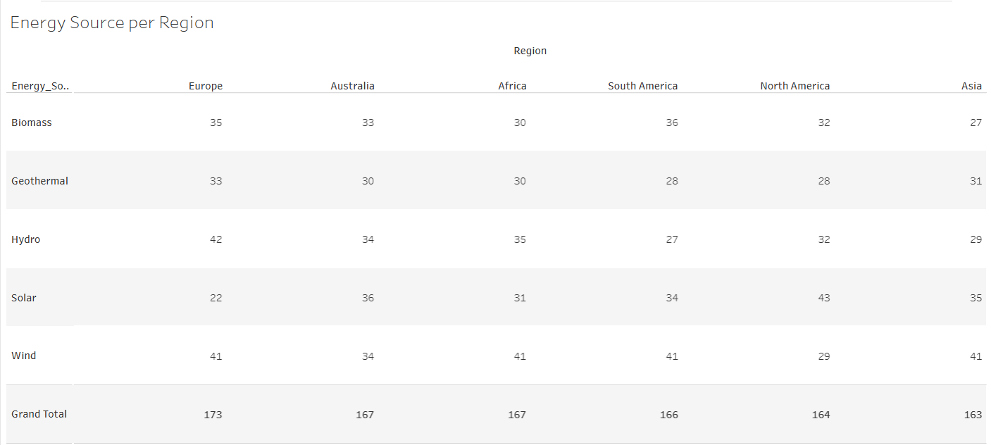
Project analysis slide 3
Renewable Energy Source
Distribution of energy sources by continent
As the photo shows, The continent of Europe is most reliant on renewable energy with total usage of 173, while Asia is the least, with total usage of 163.

Slide 6
Project analysis slide 3
Renewable Energy Source
So, What is the most used source of energy?

Slide 7
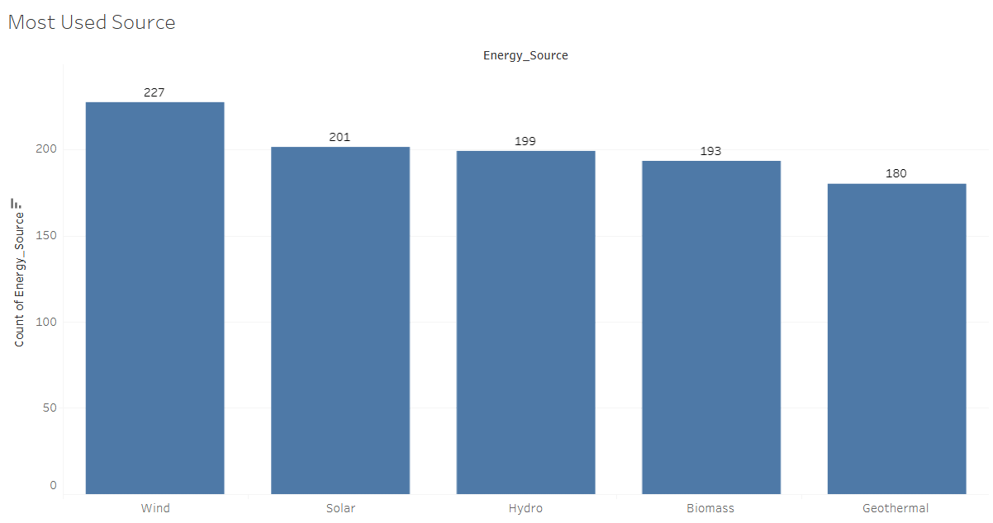
Project analysis slide 3
Renewable Energy Source
What is the most used source of energy?
The wind source is the most popular among all sources, while geothermal is the least..

Slide 8
Project analysis slide 3
Renewable Energy Source
Does that happen because the government subsidizes

Slide 9
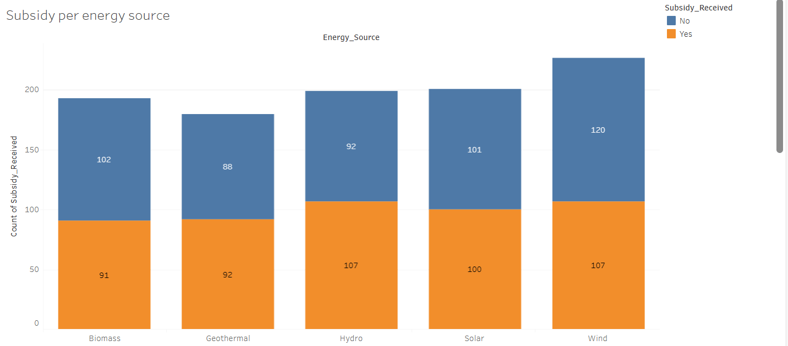
Project analysis slide 3
Renewable Energy Source
Why Wind source is the most used one?
It is clear that this is not the reason, as those benefiting from government subsidies use wind source less than those who do not receive any support as this photo shows.

Slide 10
Project analysis slide 3
Renewable Energy Source
Then, what is the reason behind that?

Slide 11
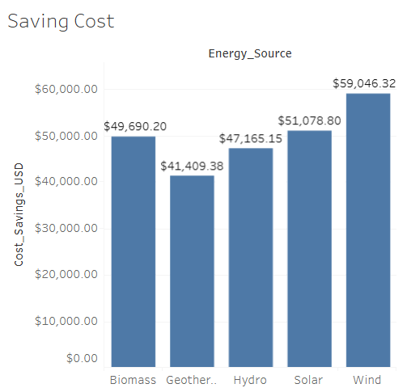
Project analysis slide 3
Renewable Energy Source
Why Wind source is the most used one?
According to the image in front of us, wind saves money more than the others, around $59,046, while geothermal saves $41,409.

Slide 12
Project analysis slide 3
Renewable Energy Source
Does that also apply to income levels?

Slide 13
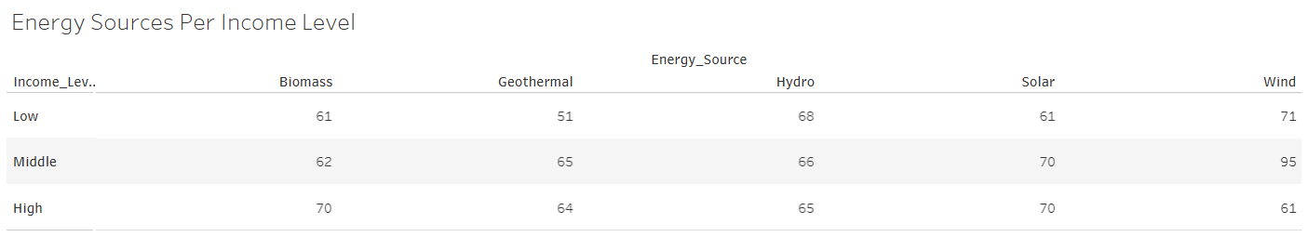
Project analysis slide 3
Renewable Energy Source
Does Wind source is the most used one through all income levels?
As the image shows, low and middle-income earners tend to use wind more than other sources, while high-income earners prefer biomass and hydro.

Slide 14
Project analysis slide 3
Renewable Energy Source
Does this indicate a bright future for wind energy?

Slide 15
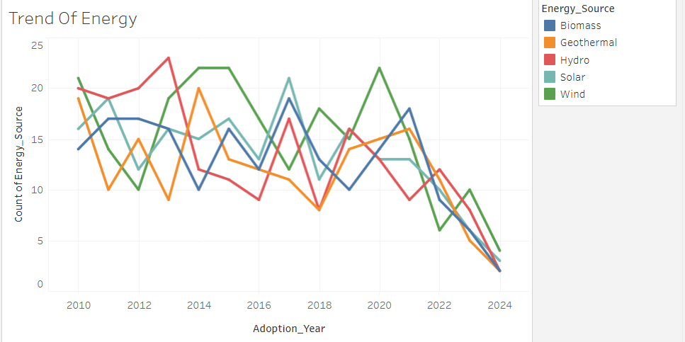
Project analysis slide 3
Renewable Energy Source
Does this indicate a bright future for wind energy?
Unfortunately, it seems that the trend for all sources of energy is declining!!

Slide 16
Project analysis slide 3
Renewable Energy Source
What about urban and rural?

Slide 17
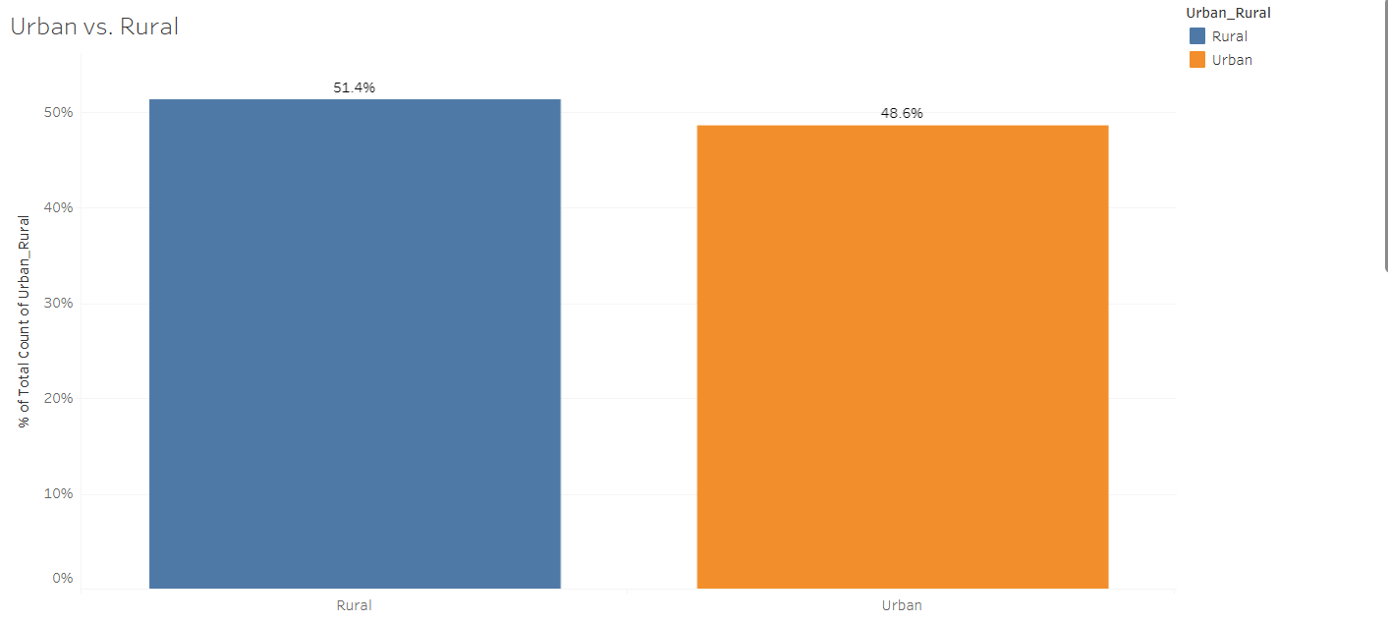
Project analysis slide 3
Renewable Energy Source
Urban vs. Rural
It seems that rural areas are more interested in renewable energy than urban areas.
This may be due to limited access to electricity and its cost in rural areas

Slide 18
Project analysis slide 3
Renewable Energy Source
Recommendations
Focus on campaigns and advertisements, specifying the preferred type for the target audience.
Intensify efforts to promote renewable energy in rural areas.

Slide 19
Project analysis slide 3
Renewable Energy Source
If you have any question or recommendation, please contact my through my LinkedIn profile

Slide 20
Thank You

